Slide 1
DECORATOR
DP Structural

Slide 2
Decorator – General Principles
Static extension at run-time of an object
The existing class is not changing
The initial object can be extended using a decorator
Initial diagram + Decorator class which extends the base class + static reference of the decorated object

Slide 3
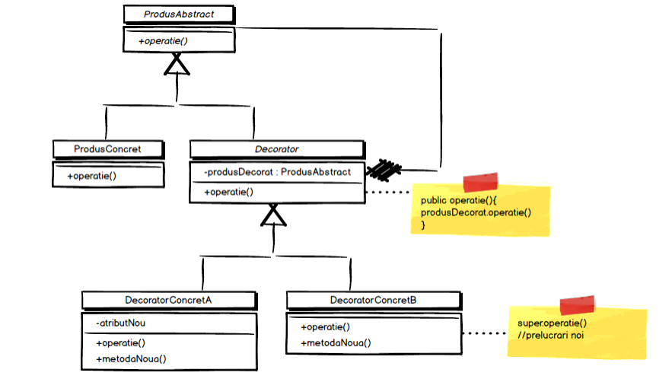
Decorator - Diagram

Slide 4
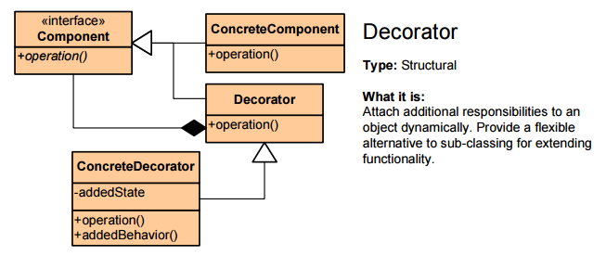
Decorator

Slide 5
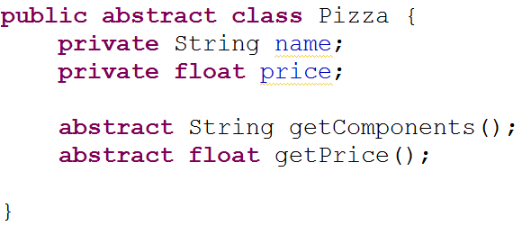
Decorator - Example

Slide 6
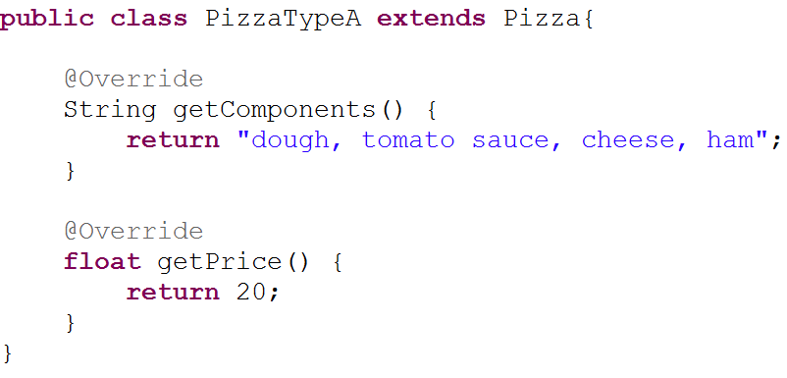
Decorator - Example

Slide 7
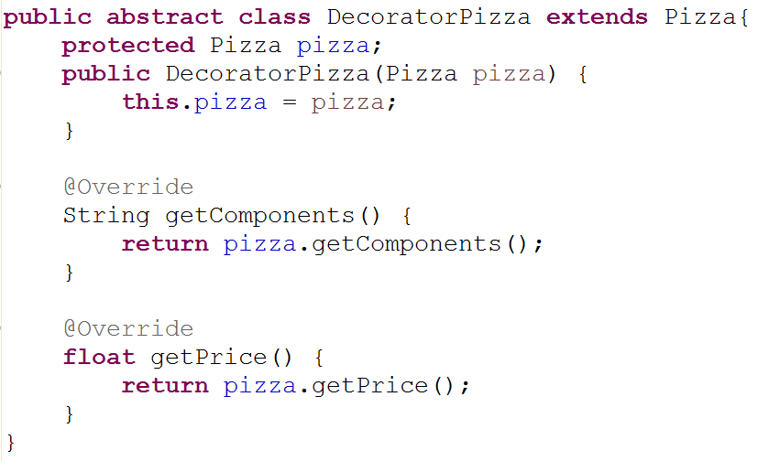
Decorator - Example

Slide 8
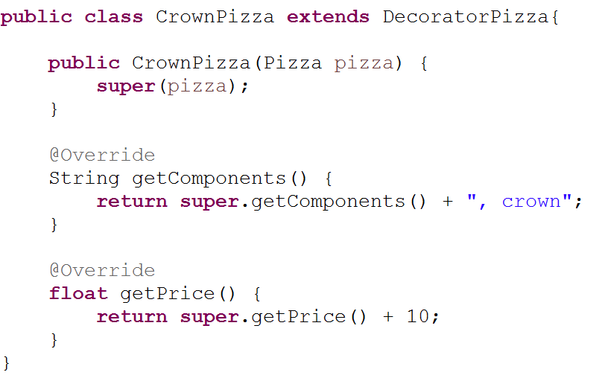
Decorator - Example

Slide 9
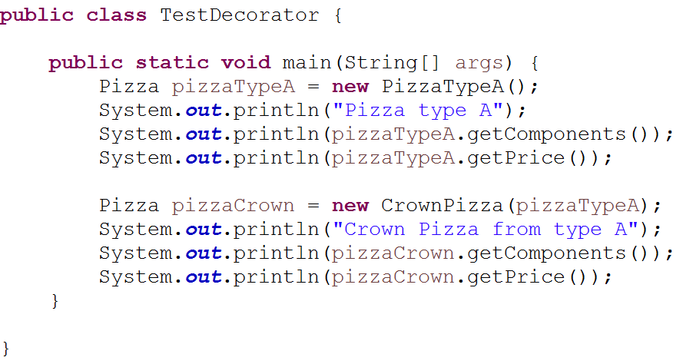
Decorator - Testing

Slide 10
COMPOSITE
DP Structural

Slide 11
Composite - General Principles
Used for creating and managing tree structures
Hierarchic view of the objects
Examples: Menu structure, Employee structure

Slide 12
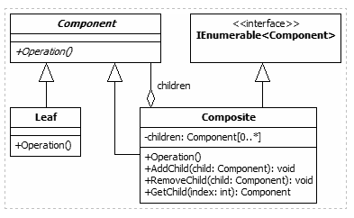
Composite - General Principles
Component – the base abstract class
Composite – includes methods, add and remove methods for childs
Leaf – leaf elements, no add
and remove methods override

Slide 13
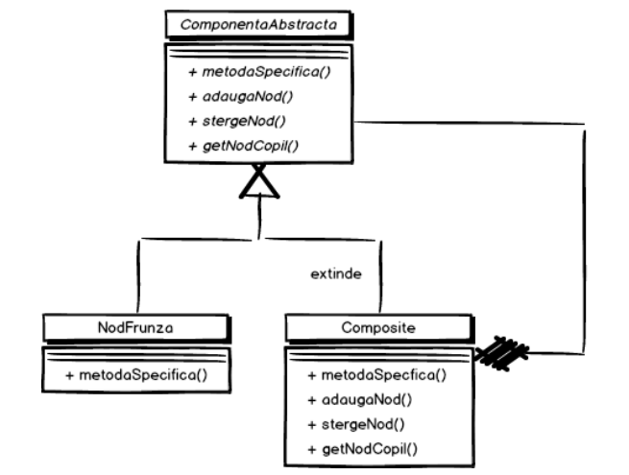
Composite - Diagram

Slide 14
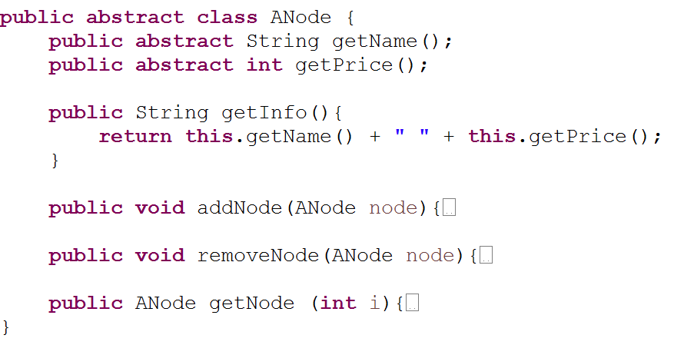
Composite - Example

Slide 15
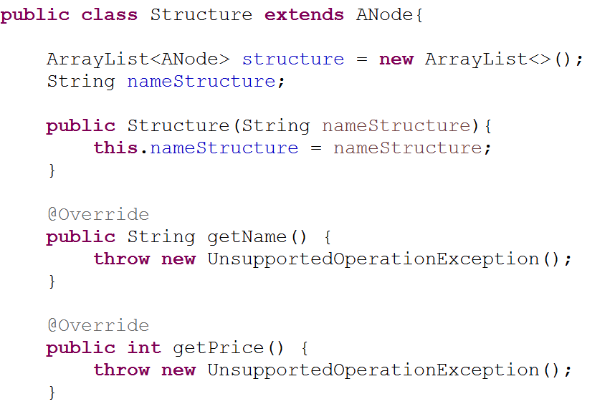
Composite - Example

Slide 16
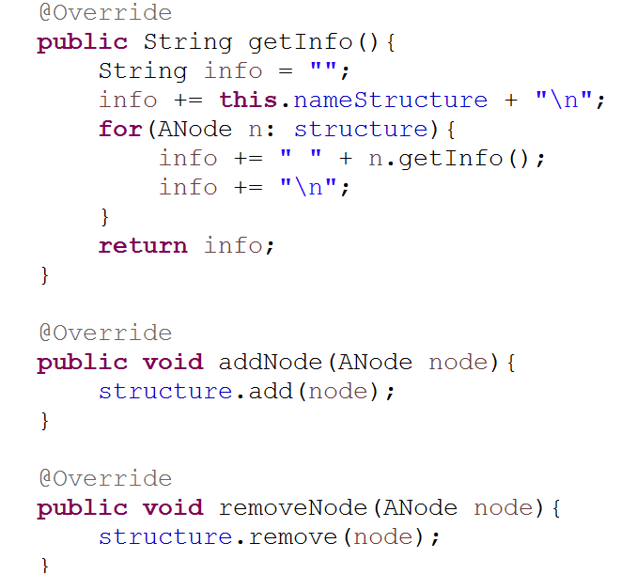
Composite - Example

Slide 17
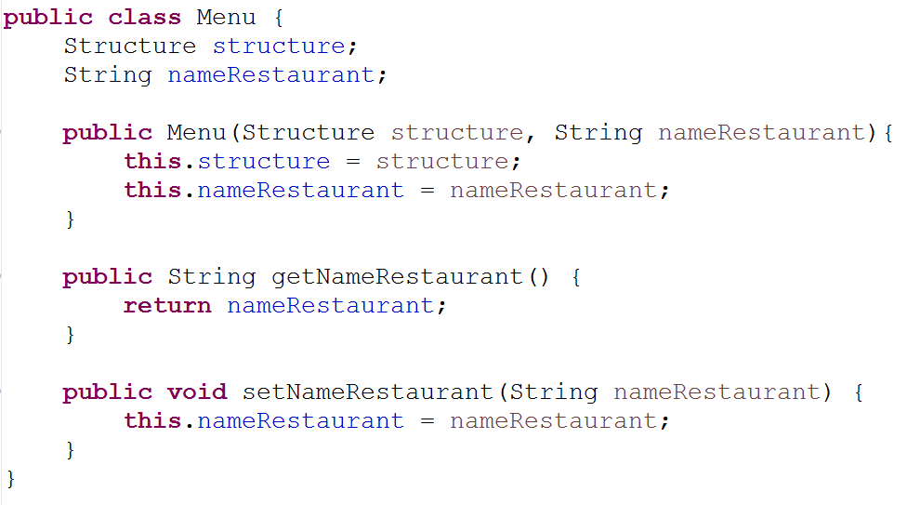
Composite - Example

Slide 18
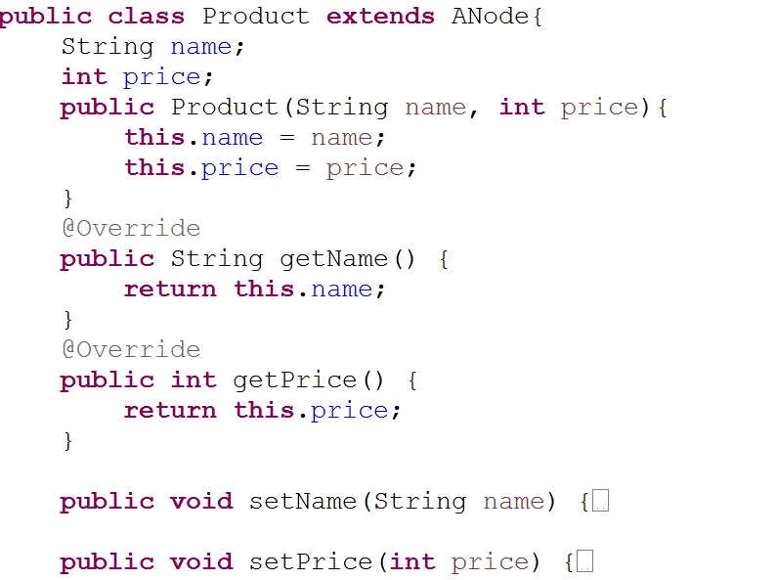
Composite - Example

Slide 19
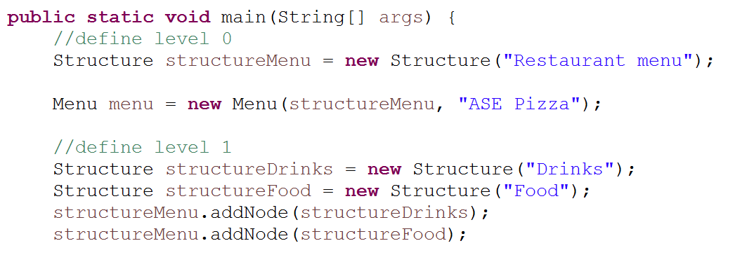
Composite - Testing

Slide 20
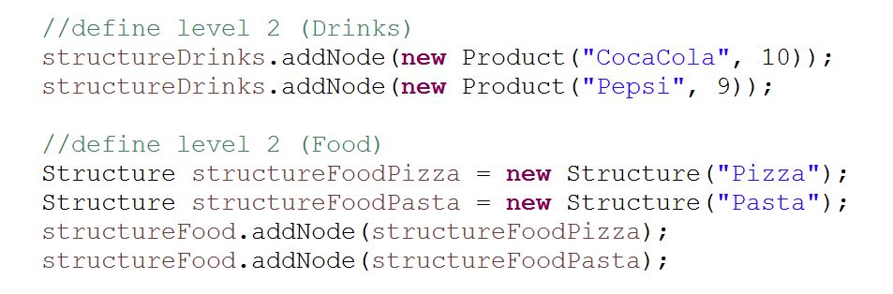
Composite - Testing

Slide 21
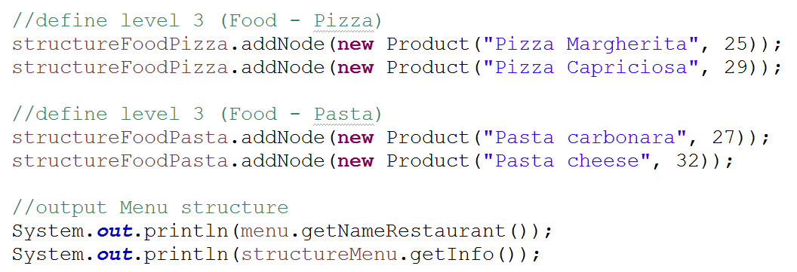
Composite - Testing

Slide 22
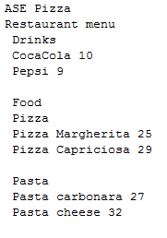
Composite - Output

Slide 23
FAÇADE
DP Structural

Slide 24
Façade – General principles
Simplified interface of the existing context
An intermediate layer is added in order to hide the complexity
New methods for simplifying are added
“In architecture, the facade of a building is often the most important from a design standpoint, as it sets the tone for the rest of the building”
(The GoF)

Slide 25
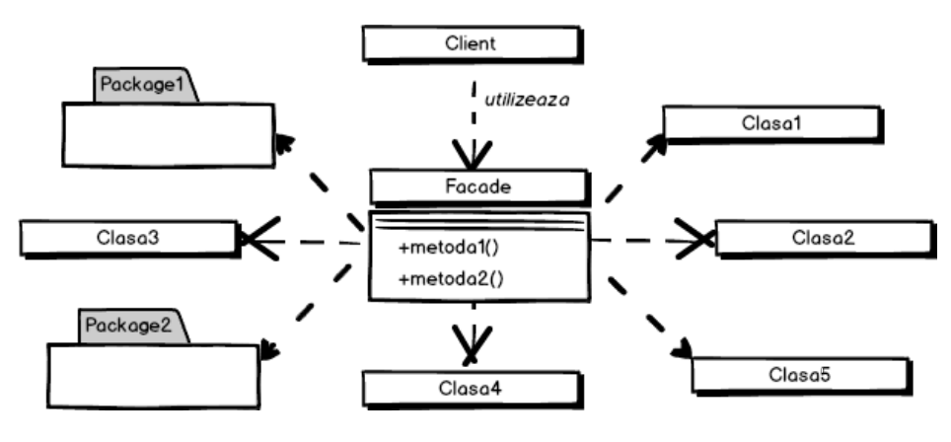
Façade - Diagram

Slide 26
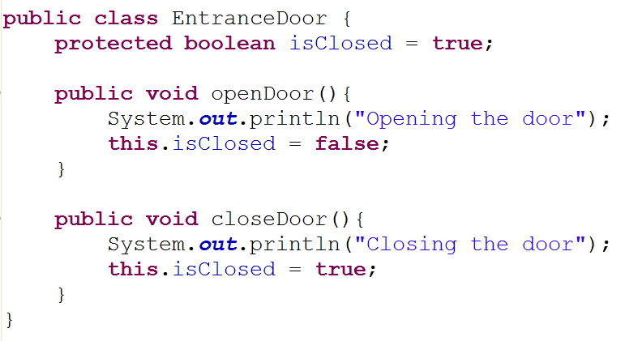
Façade – Example

Slide 27
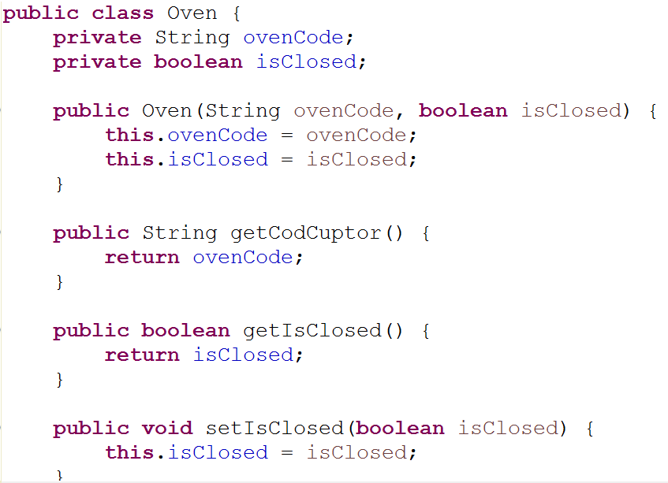
Façade – Example

Slide 28
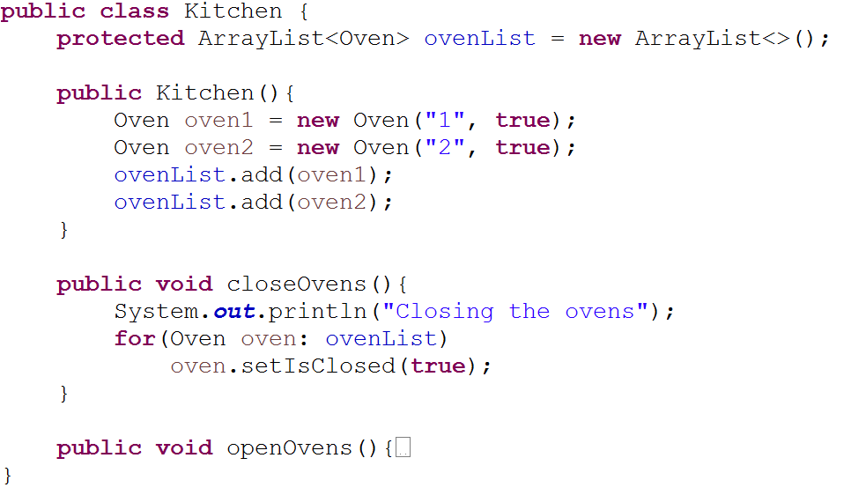
Façade – Example

Slide 29
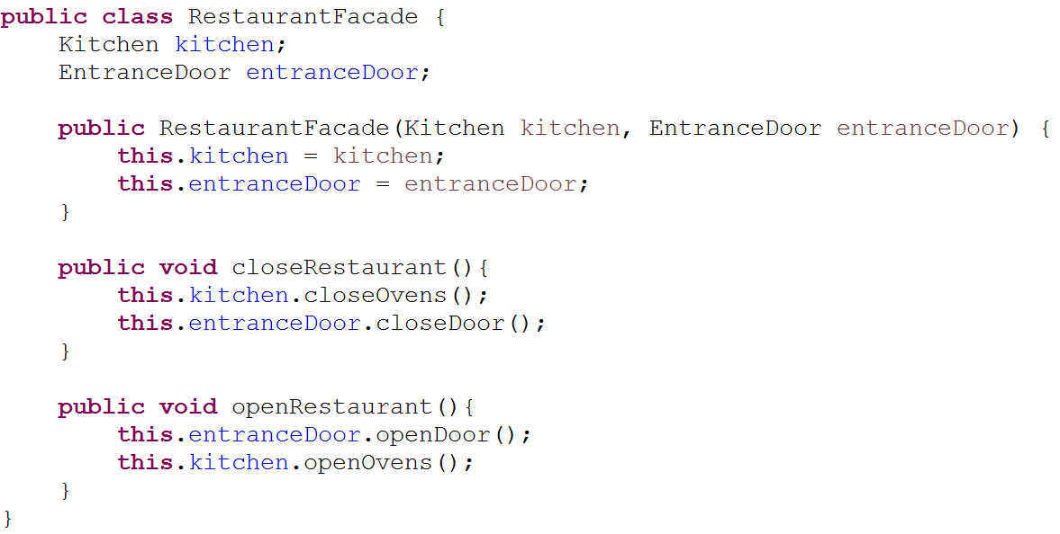
Façade – Example

Slide 30
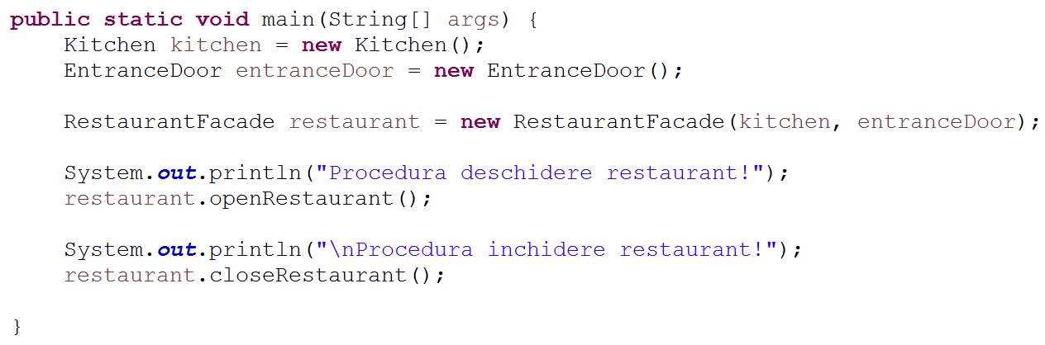
Façade - Testing

